Slide 1
Technical Deep Dive: Creating Apps for the Intelligent Cloud Day 4 – DevOps and ALM
<Presenter Name>

Slide 2
Agenda
Introduction to DevOps and ALM for Cloud Apps
Build Management
Application Testing
Deployment Strategies
Release Management
Maintaining and Monitoring Cloud Apps

Slide 3
Expectations
Introduce DevOps as a practice for developing cloud applications
How VSTS helps in this regards
Not a deep dive into specific Open Source DevOps tools
Visual Studio Online is now Visual Studio Team Services (VSTS)

Slide 4
Introduction to DevOps and ALM for Cloud Apps

Slide 5
People/Process is what % of downtime?
PROCESS
OPERATIONS
APPLICATION FAILURE
OPERATOR ERROR
Change management
Overloaded
Weak problem detection
Forget something
Lack of procedures
Backup errors/security
40%
40%
OTHER
20%
Hardware/OS
Network
Power and disaster
Gartner Security Conference presentation "Operation Zero Downtime," D. Scott

Slide 6

What’s DevOps?
It’s DevOps!
“DevOps is treating your infrastructure as code”
“DevOps is development and operations collaboration”
“DevOps is feature switches”
It’s DevOps!
It’s DevOps!
It’s DevOps!
“DevOps is small deployments”
“Kanban for Ops?”

Slide 7
What’s DevOps?
DevOps is a full lifecycle investment
DevOps is a team undertaking
DevOps enables better software development and delivery practices
DevOps accelerates the last mile of continuous delivery
App Lifecycle

Slide 8
DevOps goals and success metrics
Increase deployment frequency
Reduce change lead-time (react faster to dynamic business needs)
Reduce change fail rate
Reduce mean-time-to-detect & repair (MTTD, MTTR)
Agility performance indicators
Reliability performance indicators

Slide 9




DevOps: the three stage conversation
1
People
2
Process
3
Products

Slide 10


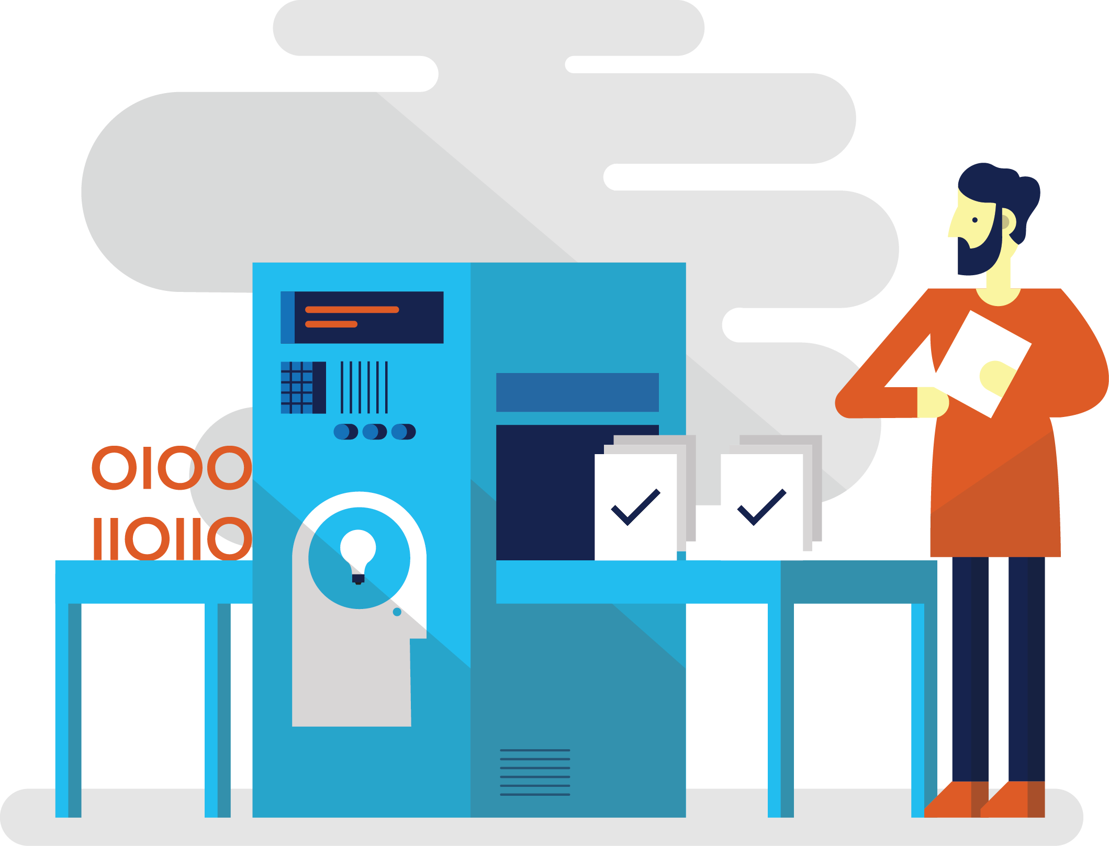


Why DevOps?
3
Improve quality and availability
4
Shorten Cycle Times
Enable HDD
1
2
Optimize resources
SLA
Do these…

Slide 11
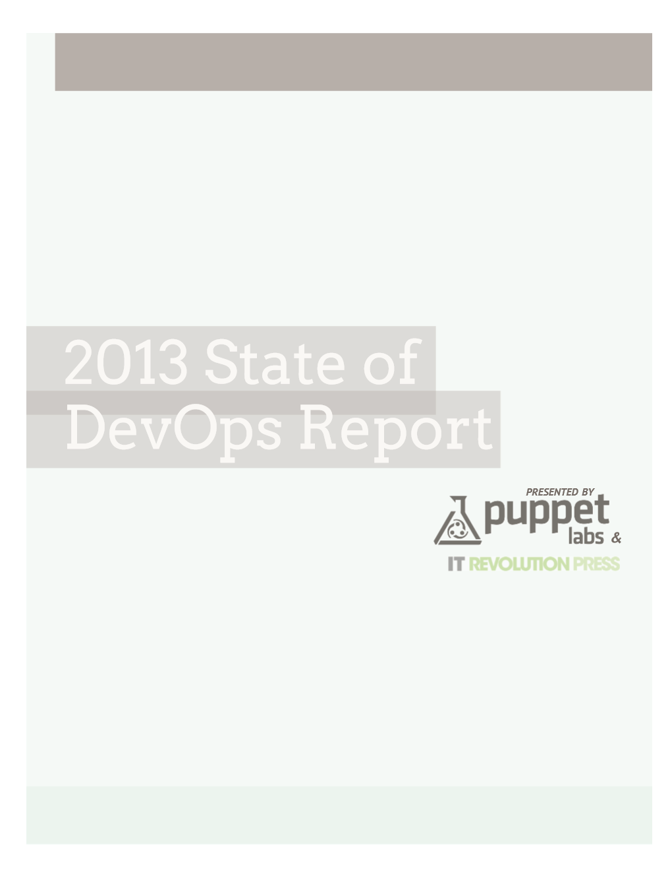
DevOps benefits
Key findings:
Organizations that implemented DevOps reported:
ORGANIZATIONS THAT HAVE IMPLEMENTED DEVOPS SAW THESE BENEFITS:
Improved quality of software deployments
High performance and reliability
IMPROVED QUALITY OF SOFTWARE DEPLOYMENTS
65%
MORE FREQUENT SOFTWARE RELEASES
63%
TOP 5 TOOLS USED TO SUPPORT DEVOPS INITIATIVES
IMPROVED VISIBILITY INTO IT
PROCESS AND REQUIREMENTS
61%
VERSION CONTROL SYSTEMS
84%
CULTURAL CHANGE
COLLABORATION/COOPERATION
55%
CONFIGURATION MANAGEMENT
78%
MORE RESPONSIVENESS TO BUSINESS NEEDS
55%
Source: https://puppetlabs.com/
MORE AGILE DEVELOPMENT
51%
TICKETING SYSTEM
68%
Ship code 30x faster
and complete those deployments 8,000 times faster than their peers.
Have 50% fewer failures
and restore service 12 times faster than their peers.
MORE AGILE CHANGE MANAGEMENT PROCESS
45%
RESOURCE MONITORING
60%
PROVISIONING
56%
IMPROVED QUALITY OF CODE
38%

Slide 12


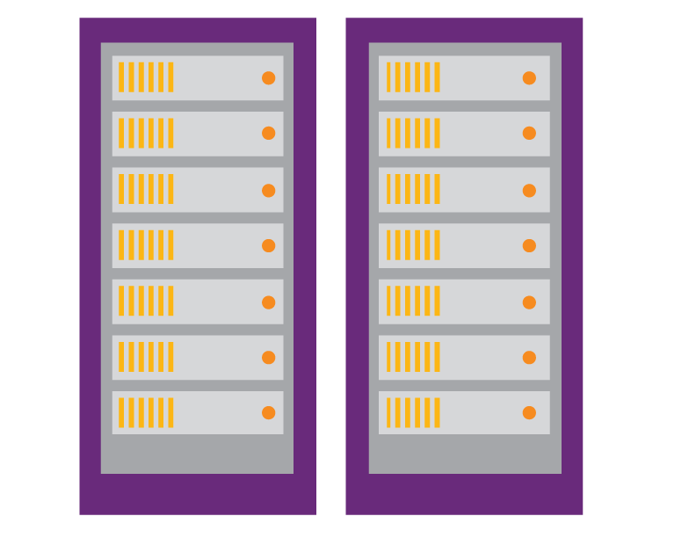
Intro to DevOps practices
Plan
Requirements
Monitor + learn
Backlog
New trend of practices for increasing flow of value to customers
Important for enterprises to understand to improve
Development
Production
Collaboration
DevOps extends application lifecycle management (ALM) investments
Develop + test
Release

Slide 13
The Application Life Cycle
Visual Studio IDE, VS Team Services, Team Foundation, Release Management, Azure
The key here is to:
Provide artifacts and common storage to be consumed throughout the pipeline
Ensure consistency at each stage

Slide 14
The Microsoft DevOps solution
TEST
DEPLOY
ENVIRONMENTS
MONITOR AND LEARN
BIZ
Online
Production
DEV
OPS
Team foundation server
Microsoft Test Manager
Microsoft Monitoring Agent
Release management for Visual Studio
Automation service
PowerShell
WAML
xPlat CLI
Azure resource management
VS Team Services application insights
Pre-production
Integration
DEVELOP
BUILD
Online
Team foundation server
Release management for Visual Studio
Online
Dev/test
Workstations
Team foundation server
PROCESSES
Team foundation server
Online
Release management for Visual Studio

Slide 15
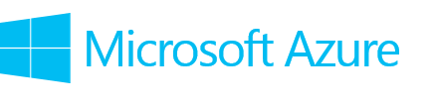




DevOps in the Cloud
Repository (Source Control)
Build
Deploy
App
Ops
IaaS
VS Team Services Application Insights
Puppet Labs
PowerShell DSC
IIS VM
SQL VM
PaaS – Cloud Service
Azure Resource Groups
Test
PaaS – App Service
Develop
VS Team Services Application Insights
Microsoft Monitoring Agent
Learn

Slide 16
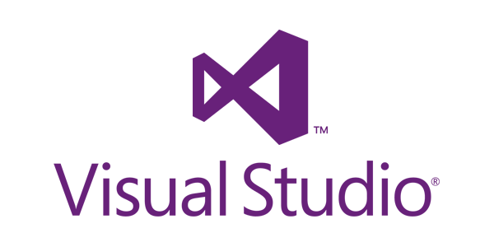



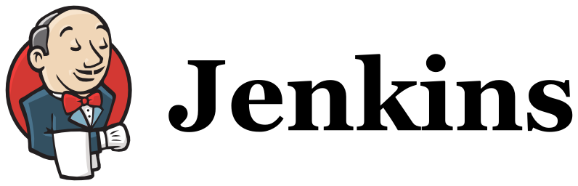

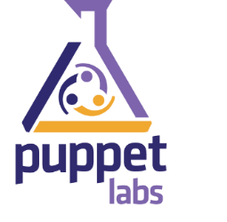

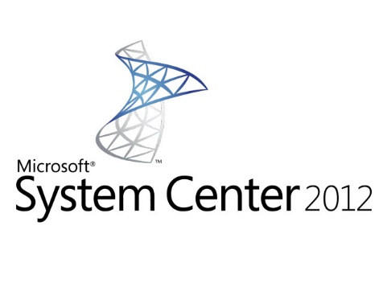

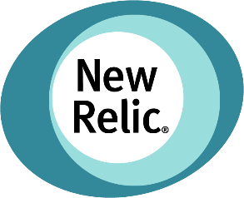
DevOps Tools on Azure – including open source
Development
Provisioning
Xplat CLI
Knife-Azure
Puppet CLI
Vagrant-Azure
Powershell
Release Management
Release Management
Config
Customization
DSC Extension
Monitoring & Diagnostics
Application Insights
OpInsights

Slide 17
Build Management

Slide 18
Continuous delivery & deployment process
Delivery team
Version control
Build & unit test
Automated acceptance test
User acceptance tests
Release
Check-in
Trigger
Feedback
Feedback
Trigger
Approval
Approval

Slide 19
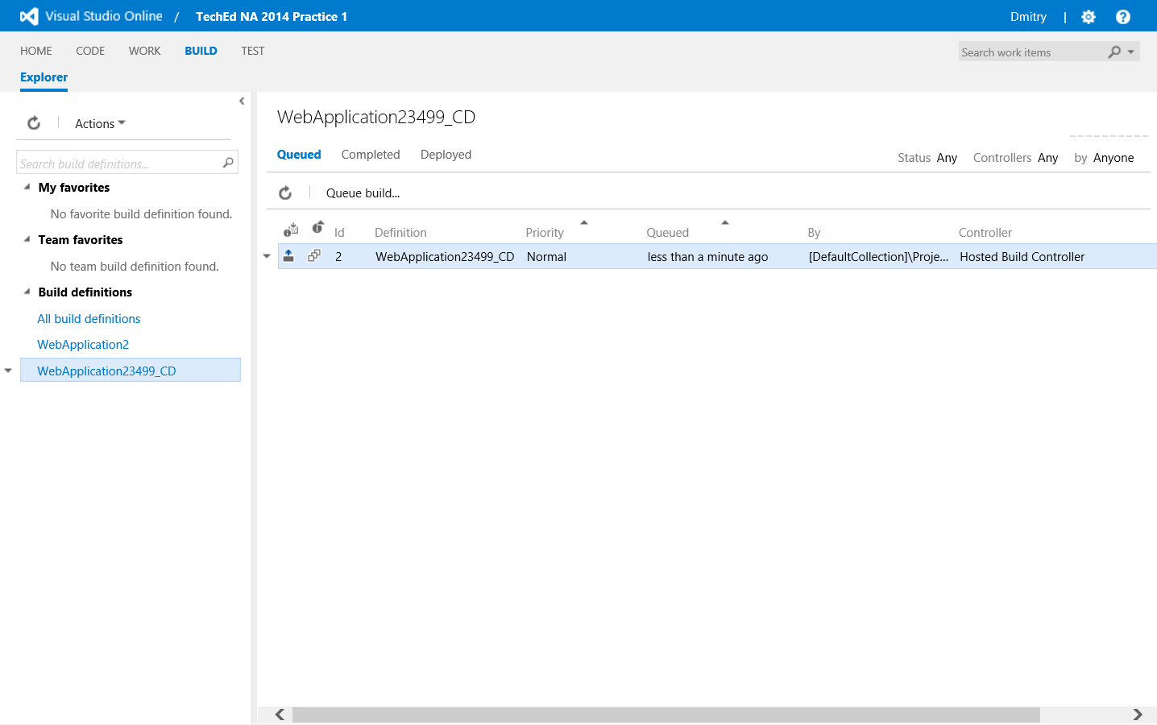

VS Team Services and Team Foundation Server
Build services
Automate your build process.
Offload your builds to the pubic cloud with Visual Studio Online, or build on-premises with Team Foundation Server.
Track build health over time.

Slide 20
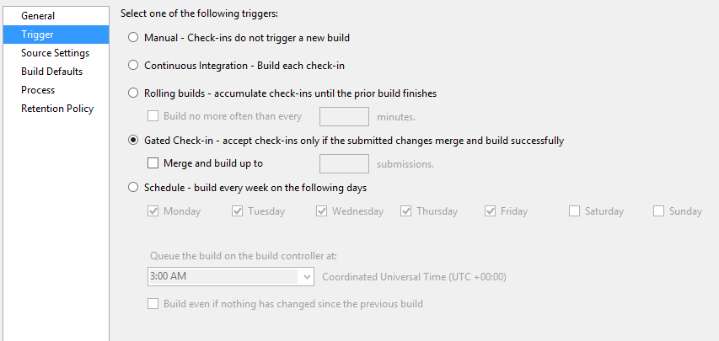
VS Team Services and Team Foundation Server
Gated check-in
Use gated check-ins to trigger builds to validate each check-in.
Batch multiple gated check-ins into one build to reduce wait time with “Merge and build up to”.
Ensure your source code repository only contains buildable and tested code.

Slide 21
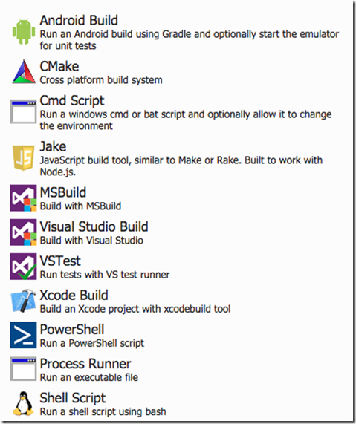
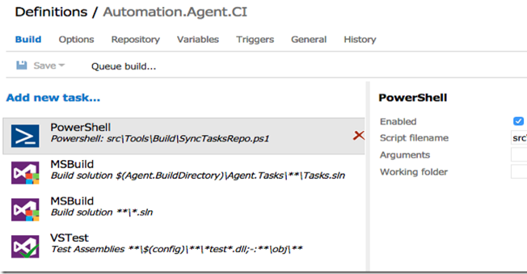
Build in VS 2015 Roadmap & VS Online
Easy Customization
Cross Platform
http://blogs.msdn.com/b/visualstudioalm/archive/2015/02/12/build-futures.aspx

Slide 22
XAML Builds
We now refer to the build automation features that shipped in TFS 2010, 2012, 2013 and VS Team Services based on the Windows Workflow engine as XAML Builds.
XAML Builds Concepts
Build Template: workflow template used by one or more build definitions, stored in version control
Build Definition: build configuration that defines activities and parameters for the build
Build: concrete execution of a build definition
Contains results, logs, report, compiled outputs, quality, etc.
Build Controller: Manages a running build, locates and activates a Build Agent
Build Agent: Executes the build definition and runs the actual compilation
Build Queue: Used to manage running builds
Build Quality: Allows build managers to track the release readiness of completed builds

Slide 23
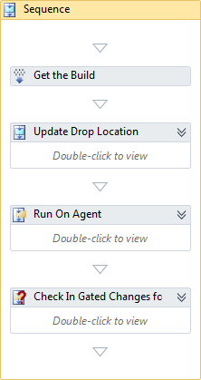
XAML Builds – Controller
Manage a set of Build Agents
Supervises the Build
Delegation – Agent Scope Activity
Deploy Content (e.g. custom assemblies)
Runs as a separate app-domain in the context of the Build Service Host

Slide 24
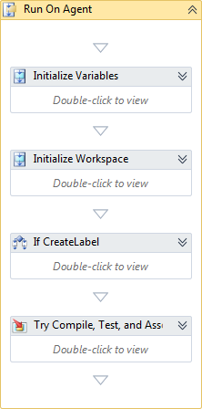
XAML Builds – Agent
Parented to a Controller
Does the “heavy lifting”
Maintains enlistments
Build-time dependencies
Multiple agents on a single machine
Runs a subset of the Build Workflow

Slide 25
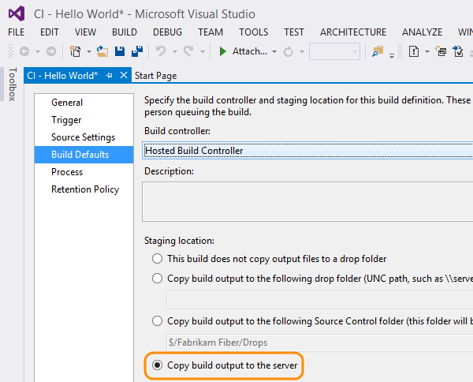
XAML Builds - Build Automation in VS Online
The process of configuring an automated build with VS Team Services is nearly identical to that of creating a build definition for Team Foundation Server

Slide 26
XAML Builds – TFS & VS Team Services Hosted Build Controller
Microsoft has been doing a significant amount of work to help make sure that the hosted build controller provided as part of VS Team Services is in parity with that of an on-premises Team Foundation Server build controller.
A detailed list of software installed on the hosted build controller can be found here: http://listofsoftwareontfshostedbuildserver.azurewebsites.net.

Slide 27
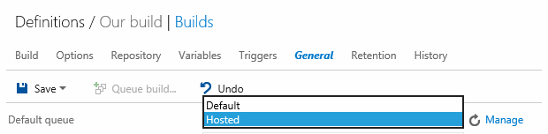
VS Team Services Hosted pool
.
Only use Hosted Pool if:
Not using XAML builds
Depend on software that is not installed on hosted build
Do not need to run more than one build at a time in your account
Do not need administrator privileges
Do not need to log on to the build server
Do not need to run your build service in interactive mode (not as a service?

Slide 28
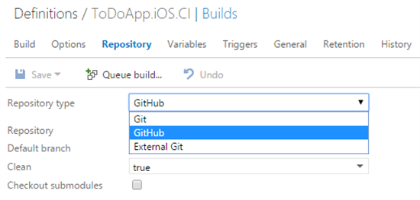
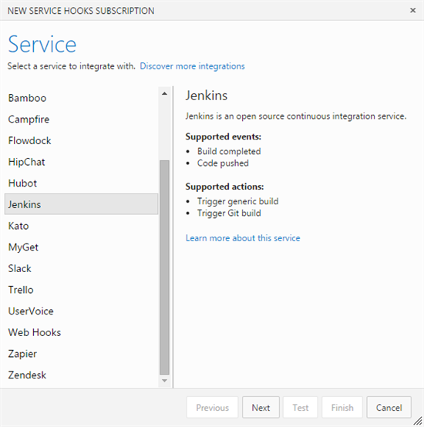
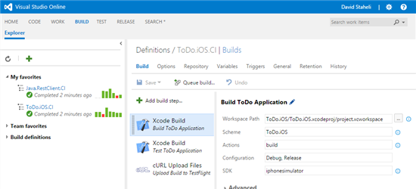
VS Team Services - Cross-Platform Build Tenants
Git, CI Servers and Service Hooks

Slide 29
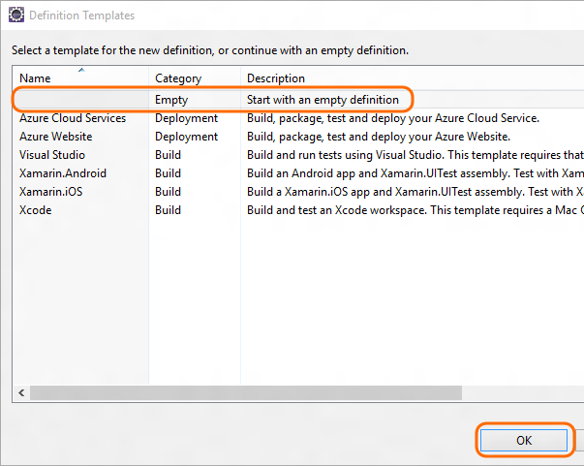
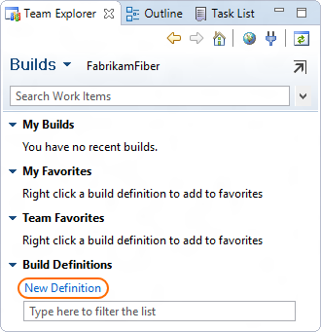
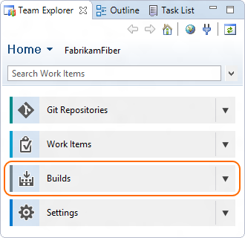
Cross Platform Builds with Eclipse
You can build your Java projects in the cloud with Ant, Gradle, or Maven and VS Team Services.
Choose Start with an empty build definition.
From the team explorer in Eclipse, open the builds page.
Create a build definition.
https://www.visualstudio.com/en-us/get-started/build/build-your-app-eclipse

Slide 30
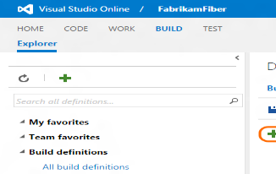
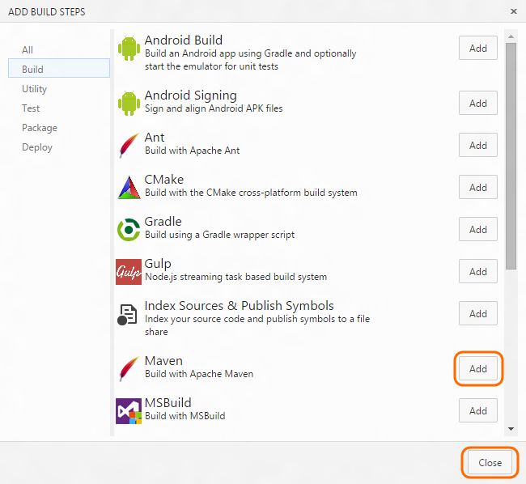
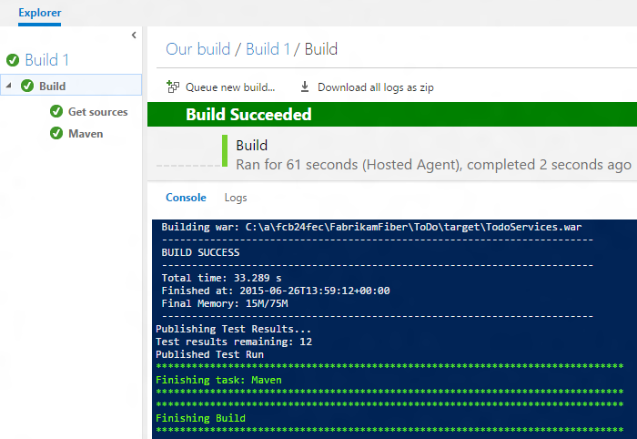
Cross Platform Builds with Eclipse
If your project builds with Maven, add the Maven build step. Otherwise add the build step your team uses.

Slide 31
Demo - Build

Slide 32
Application Testing

Slide 33

Develop + Test
Once the iteration starts, developers turn great ideas into features …
2
Write Code
Unit Testing
Version Control
Build
Build Verification
Release

Slide 34
Testing Tools
Test Manager
Exploratory Testing
Automated Tests
Test Plan Management
Advanced Testing Features
Web-Based Support
Web-Based Support
Test Runner
Web Performance and Load Testing
Web Performance Testing
Cloud and On-Premises Load Testing
Automated Testing
Coded UI Test
Extensible Unit Test framework
Code coverage

Slide 35
Application testing with Visual Studio
Microsoft Test Manager
Visual Studio IDE
Test planning and management
Test case management
Lab manager
Manual testing
Exploratory testing
Code quality analysis
Unit testing
UI automation testing
Performance testing
Load testing
Microsoft Feedback Client
User testing
Team Foundation Server/VS Online
Work item tracking
Source control
Lab management services
Test execution services
Build services
Reporting and BI
Pluggable components
Test runners
Diagnostic data collectors
Build engines
Lab environments

Slide 36
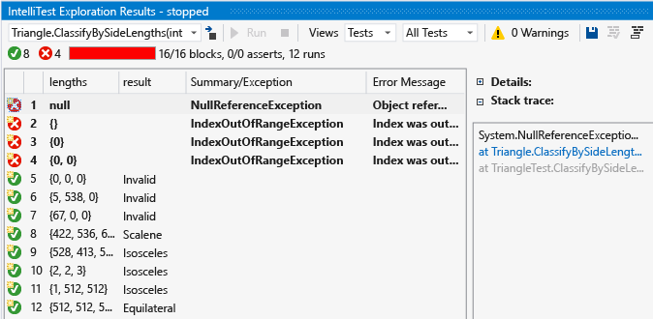
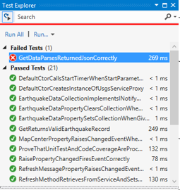
Unit Testing
Test Runner
Tests run in background automatically on build and support multiple unit testing frameworks:
MS Test, xUnit, nUnit , jUnit, oUnit, Selenium…etc
Deep integration in the IDE with multiple run options
Supports native C++ code
Easy code coverage access for all tests
Intellitest
Generate parameterized unit tests, including setup
Discover edge cases and generate unit tests for all possible code paths
Keep your tests in sync with your code changes, automatically

Slide 37
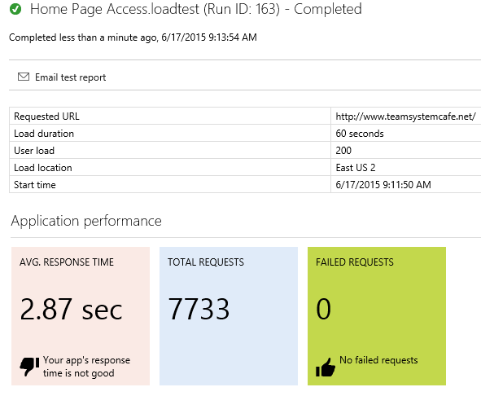
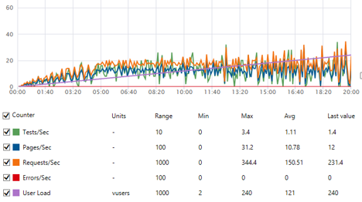

Cloud Based Load Tests
Cloud load testing
Performance test your code with hundreds of thousands of users
Author load tests from Visual Studio then use the cloud for the right load mix
Configuration options include number of virtual users, browser distribution and more
Test from where your users are
Run tests from one of many global Azure datacenter locations to minimize latency and simulate users' real-world conditions

Slide 38
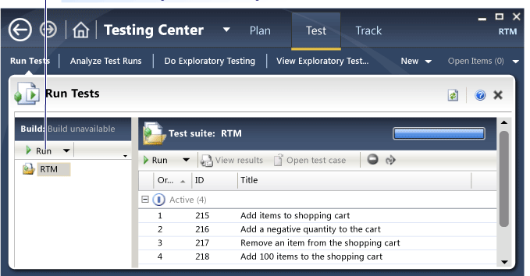
Visual Studio test tools: Test Manager
Built for generalist/manual testers, users responsible for managing/tracking the testing lifecycle
Test Case Management, Reporting
Includes Microsoft Test Runner
Run manual or automated tests
Manual test cases are work items!
Rich integration with Team Foundation Server Example: Tying requirements to test cases, Filing bugs, helping developers automate tests via action recordings

Slide 39
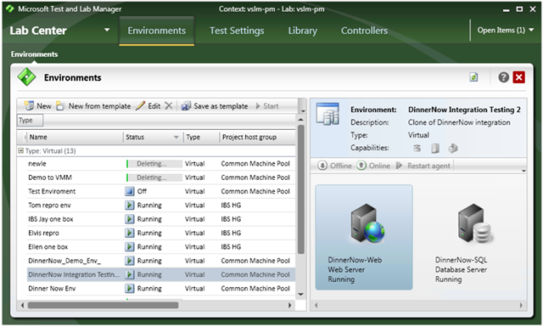
Visual Studio test tools: Lab Management
Managed via Microsoft Test Manager
Built for virtualizing test environments
Note: Integrate Hyper-V Host(s), SCVMM
Built for automating: testing environment creation, application deployment via Team Build, test runs
Manual testers can also use the environments
Simulate production like environments easily
Attach environment snapshots directly to TFS bugs!

Slide 40
Demo Suggestions - Load test in the cloud - Create test plans - Create tests - Run tests - Track test status

Slide 41
Deployment

Slide 42


Introducing Azure Resource Manager (ARM)
Test
Deploy
Environments
Monitor and Learn
DEV
OPS
Build
Azure Resource Groups
Client Workstations
Source

Slide 43
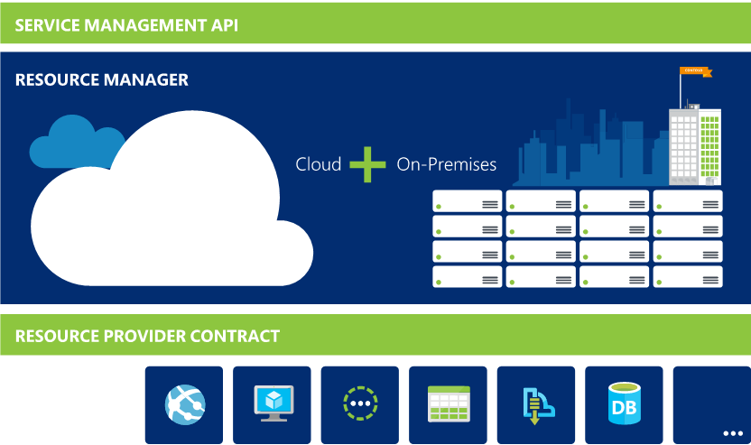
Azure Resource Manager (ARM)
Azure components as Resources through Resource Providers (RP) and REST APIs
Orchestrates changes across Azure Resource Providers
Consistent interface for Azure Resources
Resource
Providers

Slide 44
ARM – Key Customer Benefits
Resource Groups – manage collections of diverse Resources as atomic units
Role-Based Access Control (RBAC) and Tagging on any resource
Regionalized Management
RESOU
R
CE G
R
OUP

Slide 45
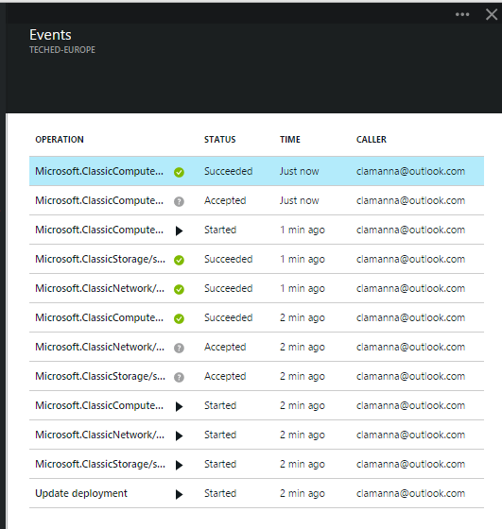
ARM: Resource Group Manager Services
Centralized auditing of operations
Simple tagging and grouping of resources
Consistent access control (e.g. RBAC)

Slide 46
ARM: Resource Tags
15
x
Tag by environment, e.g. dev/test/prod
Tag by role, e.g. web/cache/db
Tag by department, e.g. finance/retail/legal
Tag by responsible party, e.g. Bob

Slide 47
ARM: Role Based Access Control

Slide 48
Creating applications with ARM JSON templates
Template file
{
"$schema": "http://schema.management.azure.com/schemas/2014-04-01-preview/deploymentTemplate.json#",
"parameters": { … },
"variables": { … },
"resources": [
{
"type": "Microsoft.Storage/storageAccounts",
"name": "[parameters('newStorageAccountName')]",
"location": "[resourceGroup().location]",
"properties": { … }
},
{
"type": "Microsoft.Network/virtualNetworks",
"name": "[parameters('virtualNetworkName')]",
"location": "[resourceGroup().location]",
"properties": { … }
},
{
"type": "Microsoft.Network/networkInterfaces",
"name": "[parameters('networkInterfaceName')]",
"location": "[resourceGroup().location]",
"dependsOn": [
"[concat('Microsoft.Network/virtualNetworks/', parameters('virtualNetworkName'))]"
],
"properties": { … }
},
{
"type": "Microsoft.Network/loadBalancers",
"name": "[parameters('loadBalancerName')]",
"location": "[resourceGroup().location]",
"dependsOn": [
"[concat('Microsoft.Network/networkInterfaces/', parameters('networkInterfaceName'))]",
"[concat('Microsoft.Network/publicIpAddresses/', parameters('publicIpAddressName'))]"
],
"properties": { … }
},
{
"type": "Microsoft.Compute/virtualMachines",
"name": "[parameters('vmName')]",
"location": "[resourceGroup().location]",
"dependsOn": [
"[concat('Microsoft.Storage/storageAccounts/', parameters('newStorageAccountName'))]",
"[resourceId('Microsoft.Network/networkInterfaces', parameters('networkInterfaceName'))]"
],
"properties": { … }
}
]
}
PowerShell
New-AzureResourceGroup -Name 'NRP-DemoRG' –TemplateFile 'C:\sampletemplate.json' -Location 'West US‘ `
-NamedParameter1 “value” `
-NamedParameter2 “value”

Slide 49
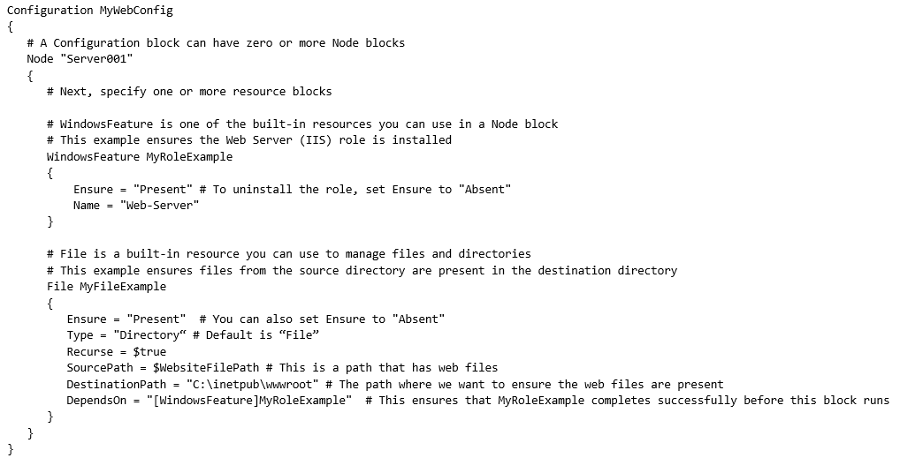
Introducing Power Shell Desired state configuration
Configuration templates
Enables you to ensure that the components of your data center have the correct configuration
Allows “continuous deployment” and prevents “configuration drift”
Uses language extensions and providers to enable declarative, autonomous and idempotent (repeatable) Deployment, Configuration and Conformance of standards-based managed elements

Slide 50
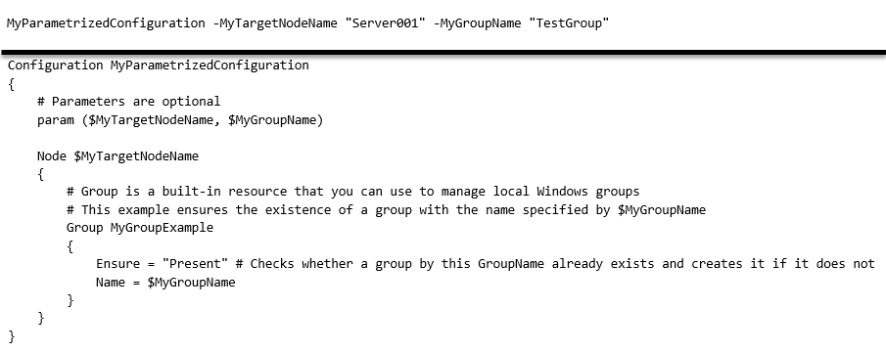
Power Shell Desired state configuration
Configuration parameters
Parameters allow reuse of configuration templates.

Slide 51
Web Deploy – IIS Apps ONLY
Web Deploy (msdeploy) simplifies deployment of Web applications and Web sites to IIS servers. Administrators can use Web Deploy to synchronize IIS servers or to migrate to newer versions of IIS. Web Deploy Tool also enables administrators and delegated users to use IIS Manager to deploy ASP.NET and PHP applications to an IIS server.

Slide 52
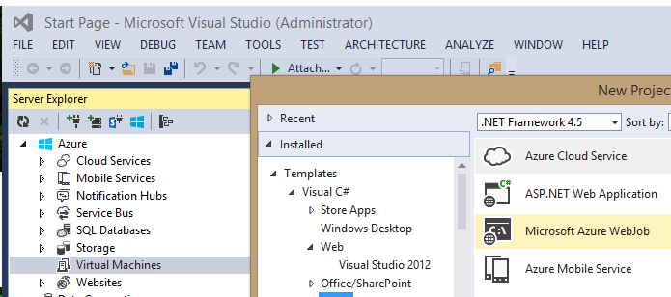
Visual Studio with WebDeploy

Slide 53

Chef Integration With Azure
IT automation platform
Build & manage complex infrastructure at massive scale.
Programmatically provision and configure
Azure specific cookbooks
VIDEO: CHEF DEPLOYMENTS TO WINDOWS AZURE

Slide 54

Puppet Labs + Microsoft Azure
Microsoft
Serves the developer and the IT pro
Puppet Labs
Automation software that enables the operational agility and efficiency of cloud computing at enterprise-class service levels
Microsoft Open Technologies, Inc.
Interoperability through open source and open standards
Wholly owned subsidiary of Microsoft
Independent cadence enables a closer interaction with open source partners
Microsoft Azure is the enterprise cloud
DevOps is an important part of the Azure story

Slide 55


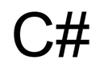



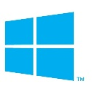
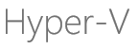
Puppet Labs automate IT infrastructure for sysadmins
Treats infrastructure-as-code to define and automate systems and applications
Application Stacks
IT Management Stack
application code & data
REPORTING
DISCOVERY
middleware
IT AUTOMATION
operating systems
ORCHESTRATION
PROVISIONING
CONFIGURATION
physical & virtual nodes
Monitoring
Help Desk
Asset Management
Service Catalog
Billing
Capacity Planning

Slide 56
Summary - Azure Programmatic Interfaces
√ = Current
√ = Resource Manager
SERVICES | POWERSHELL | XPLAT-CLI | MAML | REST | Chef, Puppet, Vagrant
Virtual Machine | √ | √ | √ | √ √ | C P V
Cloud Service | √ |  | √ | √ | C P V
Website | √ | √ | √ | √ √
Network | √ | √ | √ | √ √ | C P
Storage | √ | √ | √ | √ √ | C P V
SQL Database | √ | √ | √ | √ √ | P
Service Bus | √ | √ | √ | √
Resource Groups | √ | √ |  | √
Scheduler | √ |  | √ | √ √
Monitoring |  |  | √ | √ √
Search |  |  | √ | √ √
HDInsight | √ | √ |  | √
Mobile Services |  | √ |  | √
Azure AD | √ √ |  | √ | √
Not a complete list
Azure Resource Management APIs: https://msdn.microsoft.com/en-us/library/azure/dn948464.aspx

Slide 57
Release Management

Slide 58

Release
When all tests pass, the build is deployed to testing environments for each stage in the release process
Cloud Load Testing
Integration testing
environment
Staging
environment
3
Monitor + Learn
Automated functional testing environment
Pre-production environment

Slide 59

Continuous Delivery - Introduction
Plan
Operate
REQUIREMENTS
Agile portfolio management
BACKLOG
Visual Studio and System Center integration
Kanban customization
Work item tagging
Performance events
Build | Measure | Learn
Collaborate
Construct
Operate
Develop
Release
Team Room
Integrated release management
Git
RELEASE
Code Information Indicators
Configuration-based deployments
.NET memory Dump Analyzer
Load Testing as a Service
WORKING SOFTWARE

Slide 60
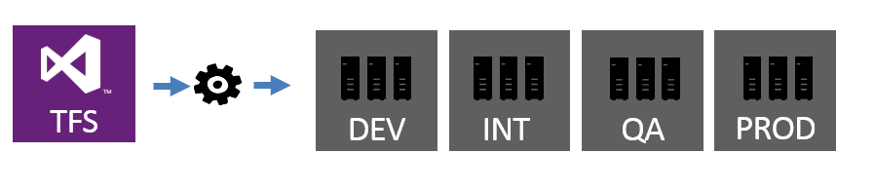
VS Online and TFS - Release Management
Create release pipelines
Define approval workflows
Automate deployments
Provides visibility and full traceability
Can use Power Shell Desired State Configuration
VS Team Services now includes Release Management

Slide 61


BudgetIT*
s
Add tasks – Dev
Environments Artifacts(1) Variables Options History
Azure
Save draft Publish Release | Export
All tasks (60) Azure (4) Test (8) Deploy (10) Other (30)
Azure Website Deployment
Deploy an Azure Website | Microsoft Corporation
BudgetIT
Add
Owner
Lan
…
Azure Cloud Application Deployment
Deploy an Azure Cloud Application | Microsoft Corporation
Add
Add environments
Add tasks…
…
…
…
…
Azure Powershell
Run an Azure Powershell script | Microsoft Corporation
Dev 0 tasks
0 approvals
No tasks here.
Solution
***.buildproj
…
Add
…
***.buildproj
…
Solution
***.buildproj
Solution
MSBuild location
Azure Resource Group Deployment
Deploy a resource group in Azure | Microsoft Corporation
MSBuild location
MSBuild location
Add
Visual Studio Location
Visual Studio Location
Visual Studio Location
Azure Dev/Test Lab Provisioning
Provision a VM or Container in a Dev/Test Lab in Azure | Microsoft Corporation
MSBuild arguments
Add
MSBuild arguments
MSBuild arguments
Platform
$(platform)
Platform
Platform
$(platform)
$(platform)
Configuration
$(config)
$(config)
Configuration
$(config)
Configuration
Clean
$(forceClean)
Clean
Clean
$(forceClean)
Restore NuGet packages
$(forceClean)
Restore NuGet packages
Restore NuGet packages
Close

Slide 62
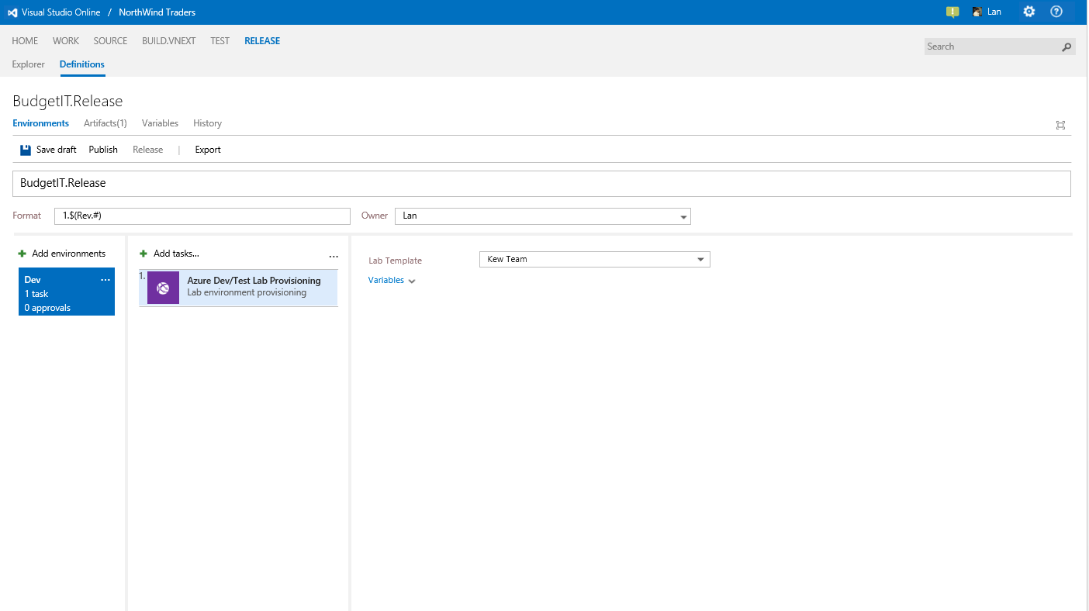

Slide 63

BudgetIT.Release*
Environments Artifacts Variables Options
Save Release
BudgetIT.Release
Add environments
Add tasks…
…
Azure Deployment:
…
1.
Manage
Dev 8 tasks
0 approvals
Azure Subscription
Azure Dev/Test Lab Provisioning
Provision VM in Azure Dev/Test Lab
Resource Group Location
North US
2.
Azure Resource Group Deploy…
Azure Deployment:
Resource Group Name
Template
$(release.artifactsDirectory)\*.json
3.
Azure File Copy
Copy file $(release.artifactsDirector
Template Parameters
$(release.artifactsDirectory)\*.params.json
Override Template Parameters
4.
Advanced Deployment Options
PowerShell on Target Machines..
PowerShell script on
Refresh SAS Token
Virtual Machine Credentials
5.
Visual Studio Test Agent Deploy…
Machine group:
Username
Password
6.
Visual Studio Test Run using Test..
Test assemblies: **\*test*.dll
PowerShell Deployment Ports
Network Protocol
WinRM Secure
Certificate
$(release.artifactsDirectory)\*.pfx
Certificate Thumbprint
Azure Key Vault
Control Options
Enabled
Continue on Error
Always Run
Always Run

Slide 64
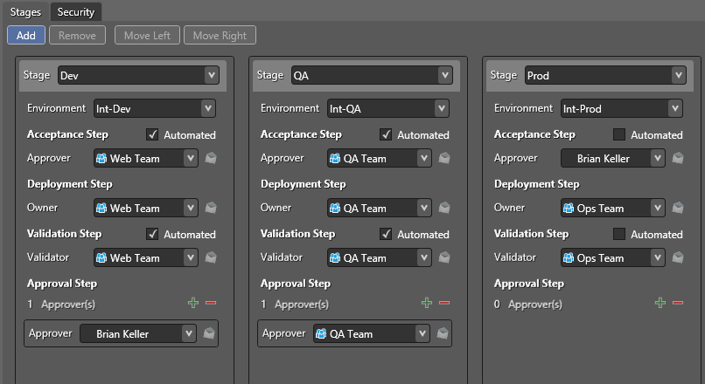
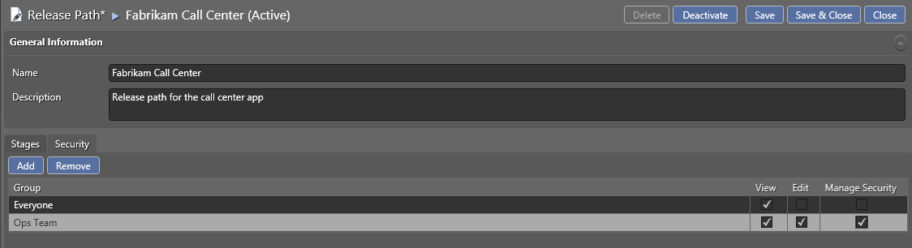
Defining the release path
Adding Security - Release Path

Slide 65
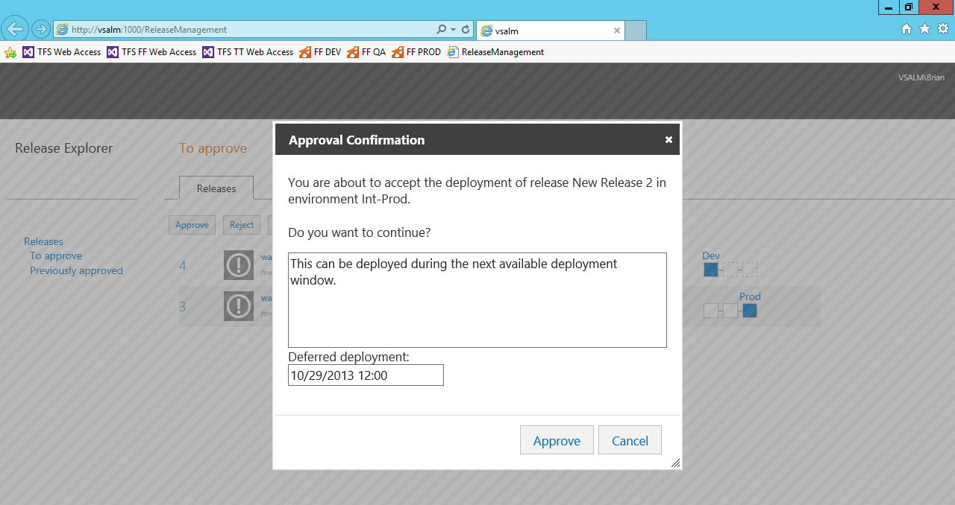
Approval

Slide 66
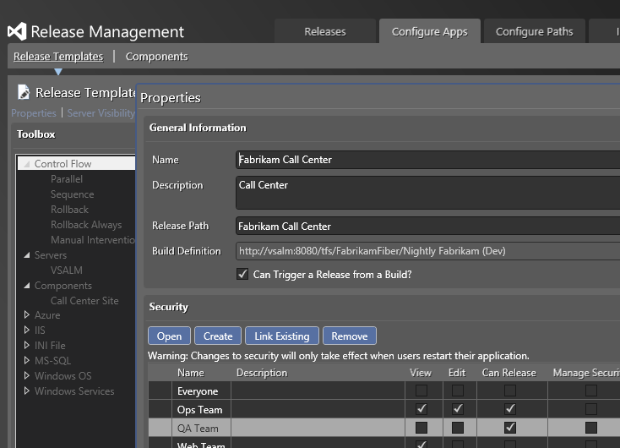
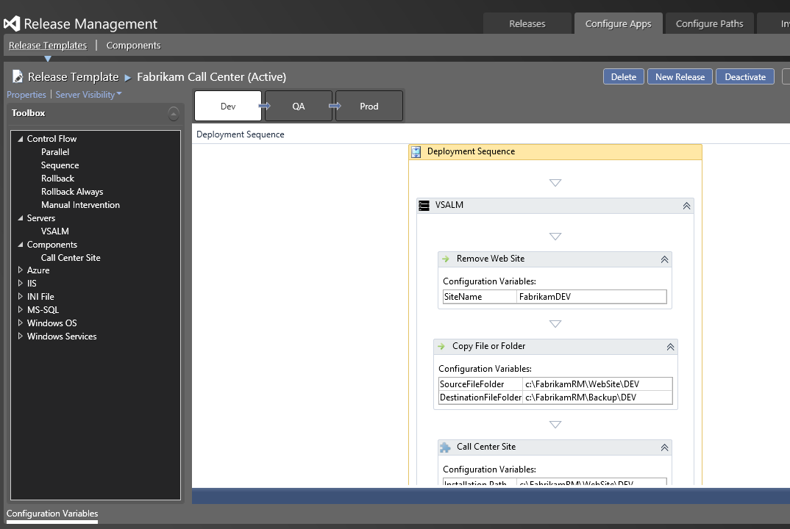
Release Template and Release
Release template:
Blueprint/workflow to deploy
Release:
Concrete transaction based on the release template
Notes:
[EDITOR] Anitha:
Monday, December 16, 2013 Comment: Please confirm if this needs to be removed.

Slide 67
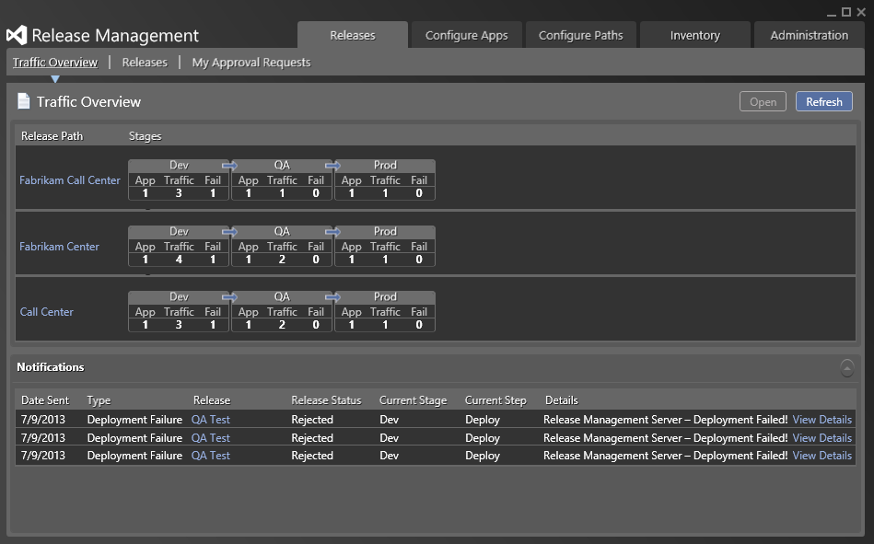
Release Visibility
https://www.visualstudio.com/en-us/get-started/test/create-a-test-plan-vs

Slide 68
Demo - Release

Slide 69
Maintaining and Monitoring Cloud Apps

Slide 70
Monitor + Learn
Learn and understand how users use your app, how it reacts and quickly fix issues and bugs
Plan the next iteration
Feedback
Monitor
4

Slide 71
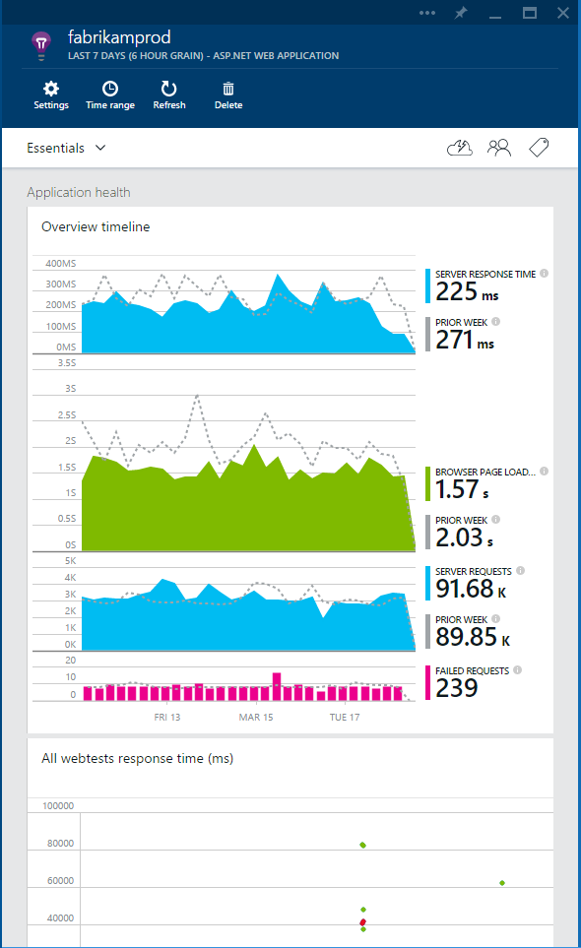
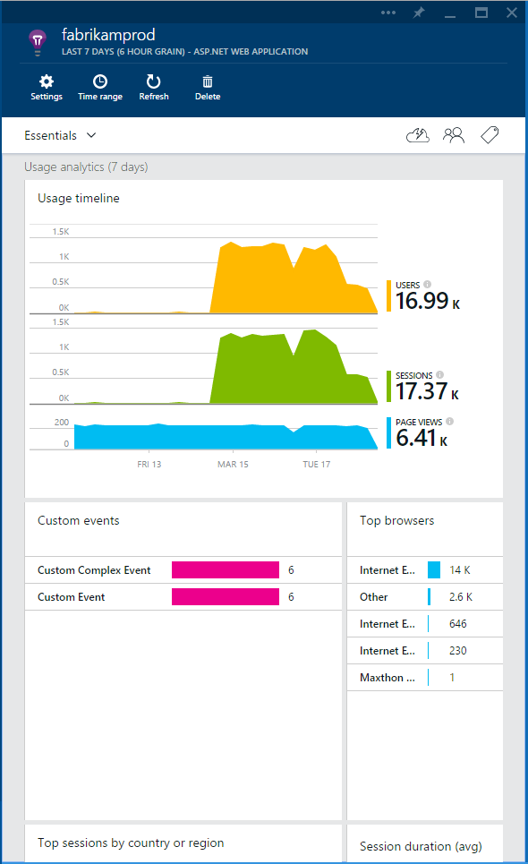



Application Insights
3
Get a 360° view of the application including availability, performance and usage patterns
1
Telemetry is collected at each tier: mobile applications, server applications and browser
Works with server apps hosted anywhere!
2
Telemetry arrives in the Application Insights service in the cloud where it is processed & stored

Slide 72
Visual Studio Application Insights
Detect issues, diagnose crashes and track usage in your web and mobile apps
Announcing Public Preview on Azure Preview Portal
Monitor ASP.NET, Java and other web apps and services
Support for Android, iOS and Windows mobile apps
Pricing details available now including free tier
Check it out!
http://azure.microsoft.com/en-us/services/application-insights

Slide 73


Key features
Get a 360° view of your application that includes availability and performance as well as user behavior
Team Collaboration
360° View
Use a powerful, easy-to-use experience to track and improve the availability, performance, and success of your app
Powerful Insights
Explore and analyze across dimensions so you can make informed decisions about your product’s future
Dev and Test
Built-in Analytics

Slide 74

Overview Blade
Out of the box experience
Provides a summary of the application’s health - availability, performance and usage
Paired timeline allows users to quickly correlate metrics and identify trends

Slide 75

Drill down
Detailed insights with the click of a button
Correlate performance and usage in a single view
Pinpoint problems and investigate questions like “Do I have network performance issues that hurt user adoption?”
Click on specific metric and drill into detailed information and answer questions such as “what request is failing the most?”

Slide 76

Drill down tools
Powerful insights with Metrics Explorer and Diagnostic Search
Metrics Explorer provides a flexible multi-dimensional UI over custom and out-of-the-box telemetry collected
Diagnostic Search enables efficient search over large sets of data using the query experience

Slide 77


Fast and powerful insights
Identify & triage availability issues
Monitor your web sites with simple pings to complex web tests from points around the world
Diagnose & solve performance problems
Quickly diagnose issues by accessing rich application performance data from the client view to dependencies
Mobile crash/sever exception analytics
Real time view of crashes happening on devices, allowing you to focus on fixing key issues with the biggest impact first

Slide 78

Fast and powerful insights
Learn & improve with usage insights
Understand where your users are coming from and where they spend most of their time
Prioritize future investments and continuously improve your app based on user activity and usage patterns and trends

Slide 79

Fast and powerful insights
Extend telemetry data
Continuously Export data to Azure Blob Storage for custom integration with other data sources and further analysis

Slide 80











Built-in Analytics
Any app support
Easily add analytics across multiple platforms including: ASP.NET, Java/J2EE, iOS, Android, Windows, as well as OSS technologies such as Node.JS, PHP, Ruby, Python, etc.

Slide 81
High level architecture

Slide 82
Transitioning Mobile Apps from Application Insights to HockeyApp
Last November at Connect(), we announced we’ll focus our efforts for mobile and desktop app developers on HockeyApp. HockeyApp is key component of our Mobile DevOps solution for building apps across platforms like iOS, Android, OS X, Windows, Xamarin, Cordova and Unity. Visual Studio Application Insights continues to focus on detect, triage and diagnose scenarios for web apps and services with interactive analytics and out-of-the-box insights.
Transition to HockeyApp
Today, we are announcing an update for our mobile and desktop app customers. As part of our investments in HockeyApp and the positive feedback we’re seeing from HockeyApp customers, we decided to sunset the mobile experiences in Application Insights.

Slide 83
Demo - App Insights for ASP.NET

Slide 84
Contact Us Technical services to help you win more deals, accelerate deployment and increase consumption
Microsoft Azure
http://aka.ms/PartnerTechnicalServicesAzure
Microsoft CRM Online
http://aka.ms/PartnerTechnicalServicesCRMOnline
Microsoft Office 365
http://aka.ms/PartnerTechnicalServicesO365
Microsoft Windows 10 and Enterprise Mobility Suite
http://aka.ms/PartnerTechnicalServicesWin10EMS
Learn more about your technical support benefits
http://aka.ms/MySupport

